Slide 1
Secure Software Design and Development (Part I: Software Security Fundamentals)
Chapter 1. Defining a Discipline
Book: Software Security: Building Security In, 1st Edition by Gary McGraw

Slide 2
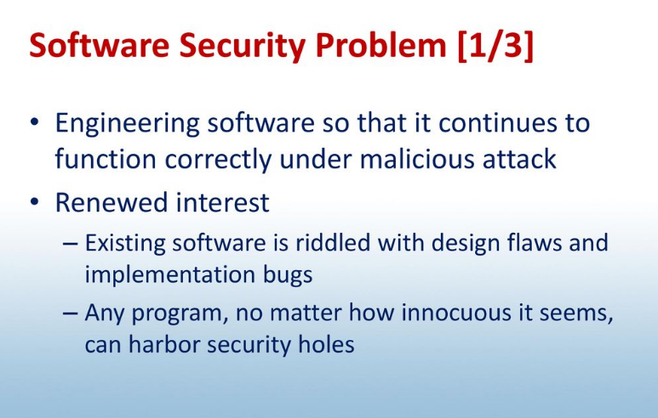
Software security

Slide 3
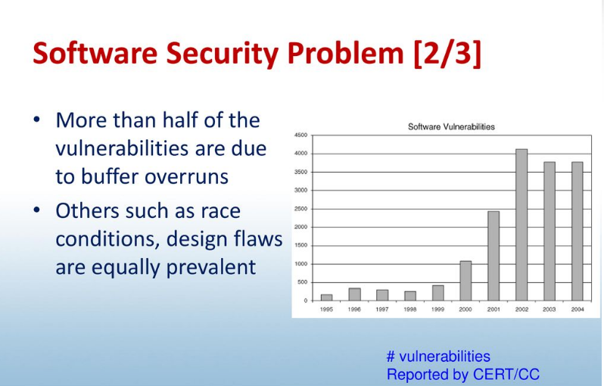
Software security

Slide 4
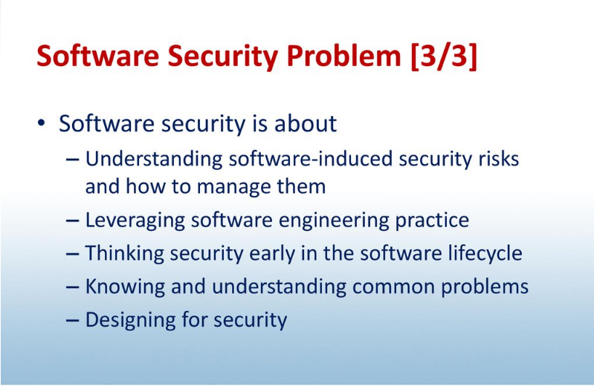
Software security

Slide 5
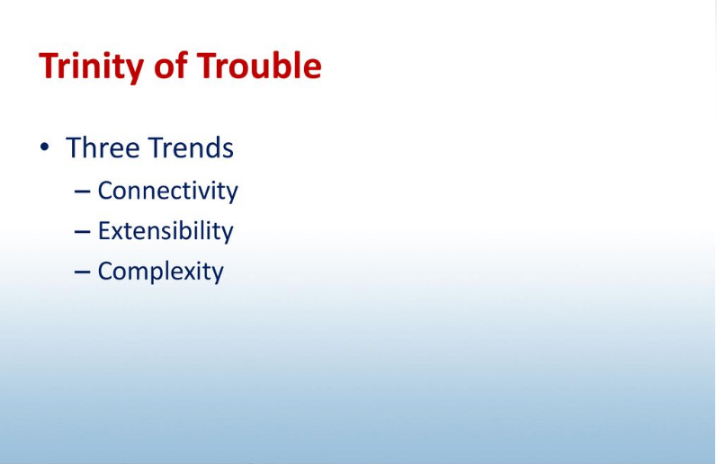
The Trinity of Trouble: Why the Problem Is Growing

Slide 6
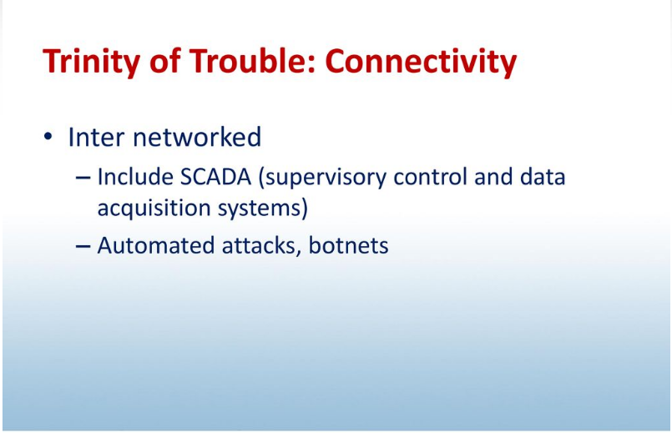
The Trinity of Trouble: Why the Problem Is Growing

Slide 7
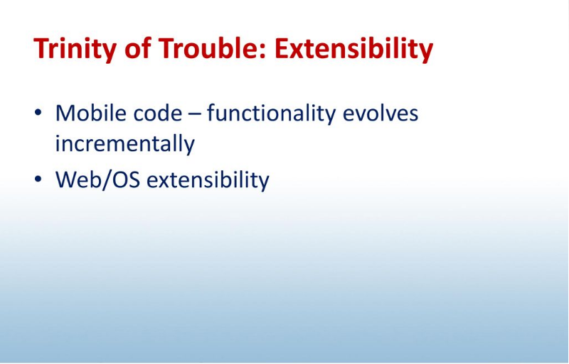
The Trinity of Trouble: Why the Problem Is Growing

Slide 8
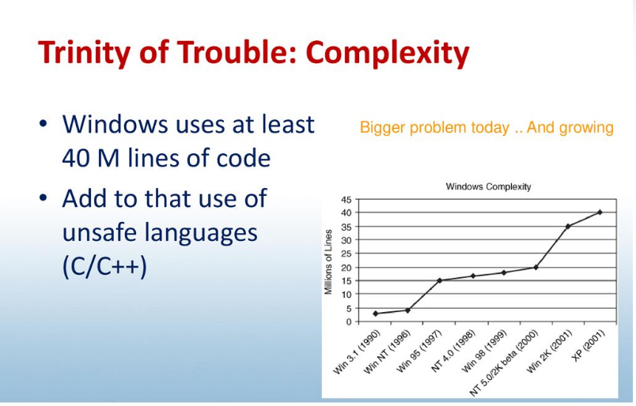
The Trinity of Trouble: Why the Problem Is Growing

Slide 9
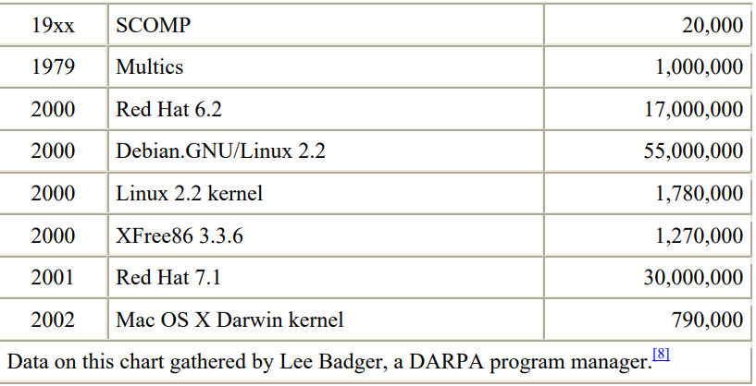
The Trinity of Trouble: Why the Problem Is Growing

Slide 10
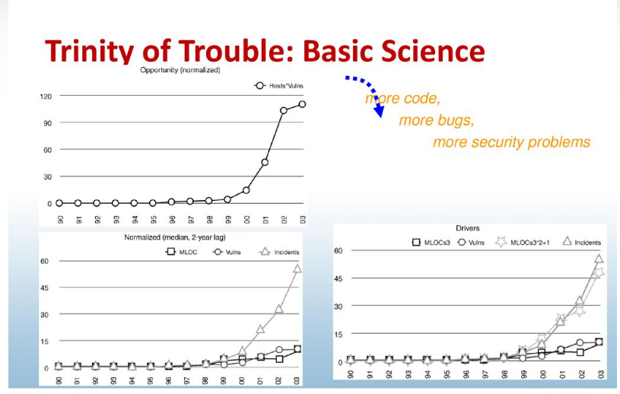
The Trinity of Trouble: Why the Problem Is Growing

Slide 11
Security Problems in Software
Software security, that is, the process of designing, building, and testing software for security, gets to the heart of computer security by identifying and expunging problems in the software itself.
In this way, software security attempts to build software that can withstand attack proactively.

Slide 12
Bugs and Flaws and Defects, Oh My!
(Basic terminologies)
Defect: Both implementation vulnerabilities and design vulnerabilities are defects. A defect is a problem that may lie dormant in software for years only to surface in a fielded system with major consequences.
Examples:
Usability defects hinder the user experience
A Login button doesn't allow users to login
Bug: A bug is an implementation-level software problem. Bugs may exist in code but never be executed. Bugs are implementation-level problems that can be easily discovered and remedied.
Examples:
Buffer Overflow: An Implementation Bug.
Hardware usage error
Typos

Slide 13
Bugs and Flaws and Defects, Oh My!
(Basic terminology)
Flaw: A flaw is a problem at a deeper level. Flaws are often much more subtle than simply an off-by-one error in an array reference or use of an incorrect system call. A flaw is certainly instantiated in software code, but it is also present (or absent!) at the design level.
Examples:
A number of classic flaws exist in error-handling and recovery systems that fail in an insecure or inefficient fashion.
Software Crash
Bugs + Flaws leads to Risks

Slide 14
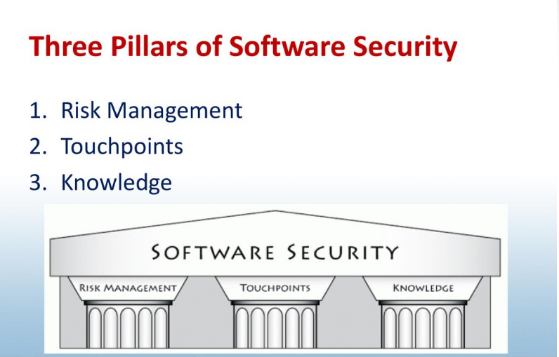
Solving the Problem: The Three Pillars of Software Security

Slide 15
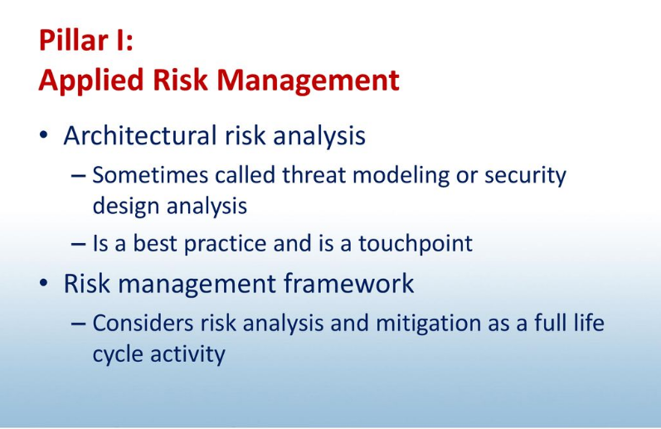
Solving the Problem: The Three Pillars of Software Security

Slide 16
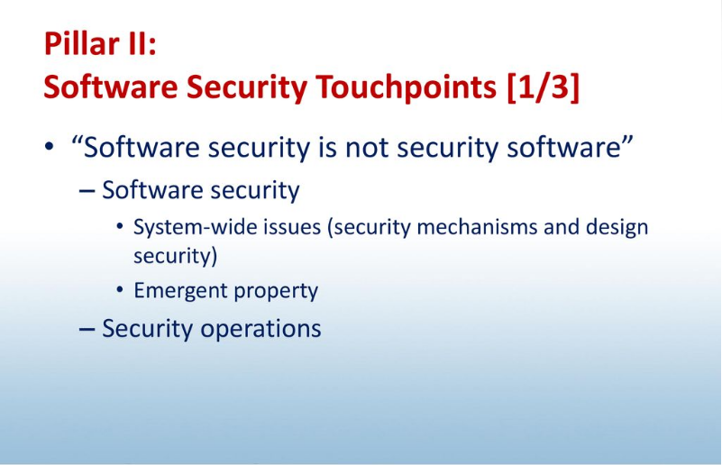
Solving the Problem: The Three Pillars of Software Security

Slide 17
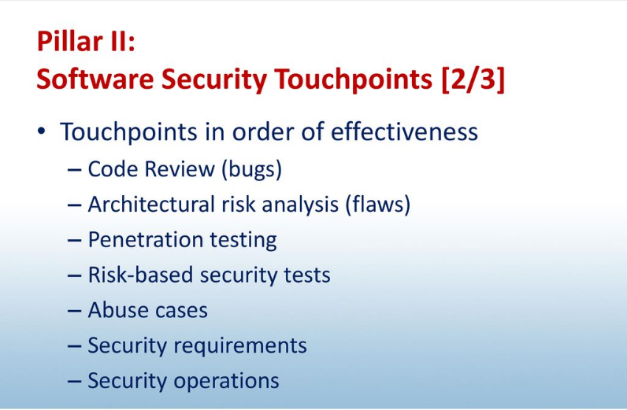
Solving the Problem: The Three Pillars of Software Security

Slide 18
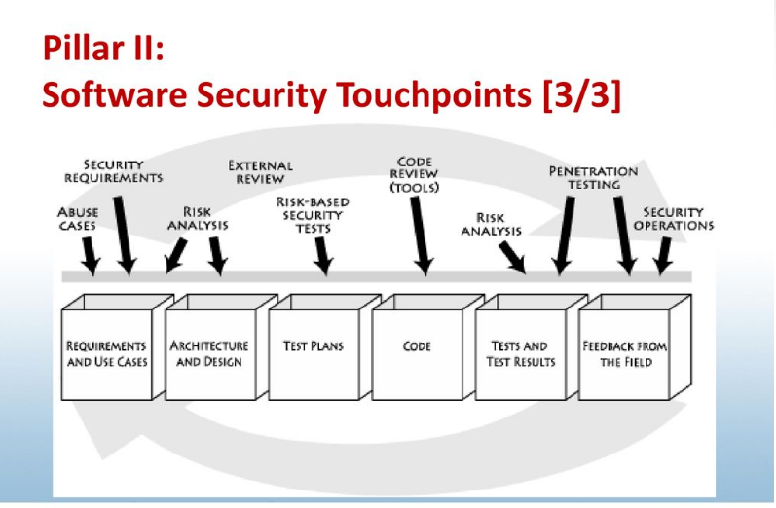
Solving the Problem: The Three Pillars of Software Security

Slide 19
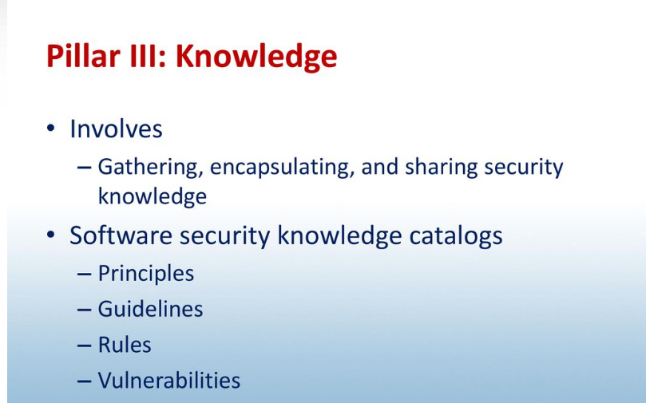
Solving the Problem: The Three Pillars of Software Security

Slide 20
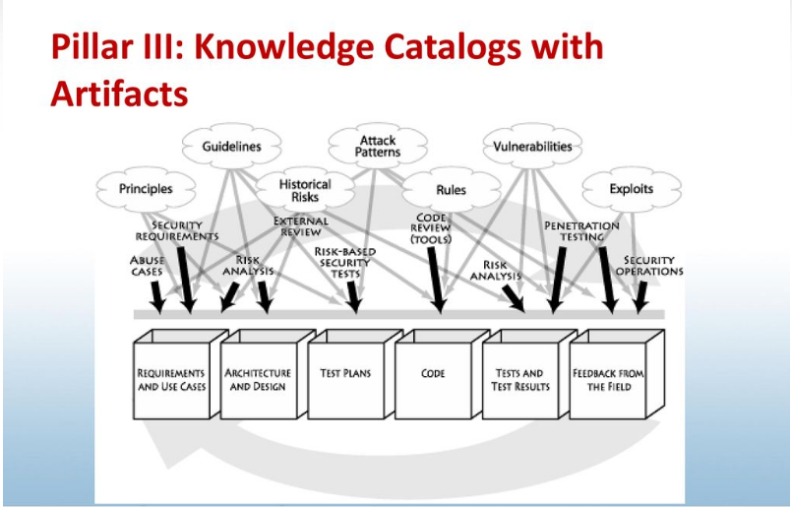
Solving the Problem: The Three Pillars of Software Security

Slide 21
The Rise of Security Engineering
Designers of modern systems must take security into account proactively. This is especially true when it comes to software because bad software lies at the heart of a majority of computer security problems.
Software defects come in two flavors—designlevel flaws and implementation bugs.
To address both kinds of defects, we must build better software and design more secure systems from the ground up.
Most computer security practitioners today are operations people. They are adept at designing reasonable network architectures, provisioning firewalls, and keeping networks up.
This leads to the adoption of weak reactive technologies (think "application security testing" tools). Tools like those target the right problem (software) with the wrong solution (outside in testing).

Slide 22
The Rise of Security Engineering
Fortunately, things are beginning to change in security. Practitioners understand that software security is something we need to work hard on.
If we are to build systems that can be properly operated, we must involve the builders of systems in security. This starts with education, where security remains an often-unmentioned specialty, especially in the software arena.
Every modern security department needs to think seriously about security engineering.
The best departments already have staff devoted to software security. Others are beginning to look at the problem of security engineering

Slide 23
Software Security Is Everyone's Job
Connectivity and distributed computation is so pervasive that the only way to begin to secure our computing infrastructure is to enlist everyone.
Builders must practice security engineering, ensuring that the systems we build are defensible and not riddled with holes (especially when it comes to the software).
Operations people must continue to architect reasonable networks, defend them, and keep them up.

Slide 24
Software Security Is Everyone's Job
Administrators must understand the distributed nature of modern systems and begin to practice the principle of least privilege.
Users must understand that software can be secure so that they can take their business to software providers who share their values. (Witness the rise of Firefox.) Users must also understand that they are the last bastion of defense in any security design and that they need to make tradeoffs for better security.
Executives must understand how early investment in security design and security analysis affects the degree to which users will trust their products.

